Slide 1
TITTLE:FINANCIAL MANAGEMENT 192111307 k.HARSHA VARDHAN REDDY 192110040 S.RANJITH KUMAR REDDY

Slide 2
ABSTRACT:
Sees the objective of teaching financial management to be to help managers and potential managers to make sensible investment and financing decisions.
Acknowledges that financial theory teaches that investment and financing decisions should be based on cash flow and risk.
Financial management refers to the efficient and effective management of money (funds) in such a manner as to accomplish the objectives of the organization.
It is the specialized function directly associated with the top management.
The significance of this function is not seen in the 'Line' but also in the capacity of 'Staff' in overall of a company

Slide 3
INTRODUCTION
Let’s define financial management as the first part of the introduction to financial management.
For any business, it is important that the finance it procures is invested in a manner that the returns from the investment are higher than the cost of finance.
In a nutshell, financial management Endeavors to reduce the cost of financeEnsures sufficient availability of fundsDeals with the planning, organizing, and controlling of financial activities .

Slide 4
The procurement and utilization of funds
Financial management is that area of business management devoted to a judicious use of capital and a careful selection of the source of capital in order to enable a spending unit to move in the direction of reaching the goals.
Financial management "is the operational activity of a business that is responsible for obtaining and effectivelyutilising the funds necessary for efficient operations".

Slide 5

Financial management is concerned with three key activities namely:
•Anticipating financialneeds
•Acquiring financialresources
•Allocating funds inbusiness

Slide 6
LITERATURE SURVEY:
This review of literature on experience with Public Financial Management Reform was commissioned by DFID
Behalf of the Dutch Ministry of Foreign Affairs, the Swedish International Development Cooperation Agency (Sida), the Canadian International Development Agency (CIDA)
And the African Development Bank (AfDB). It was envisaged as the preliminary stage of a joint evaluation, and was overseen by a Steering Group of experts from the contributing agencies.

Slide 7
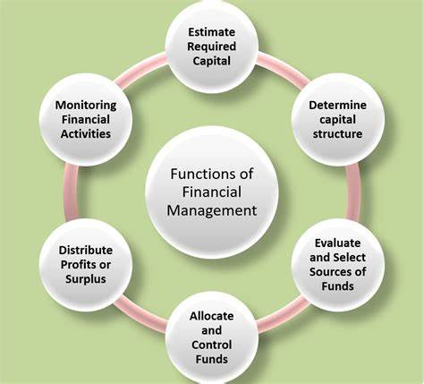
Strong Public Financial Management (PFM) systems are essential to improved service delivery, poverty reduction and to achievement of
the MDGs. Effective PFM systems maximise financial efficiency, improve transparency and accountability, and – in theory
– will contribute to long-term economic success.

Slide 8
Organisaton management facilitates beter decision making by providing all fnancial informaton regarding
Available to all business users. It is called transparency of informatIn fnancial management concept
All informaton’s collected are ron that helps to develop beter ecorded systematcally and made it understanding.

Slide 9
And should not go above the pre-set standards. This facilitates fnaThe fnance manager ensure that all actvites of business are in accornce controldance with the estmated costs
Wastage management ensures that all fnancial resources are efciently utlised and there is no
Financial management aims at raising the proft of the concern and wealth of the shareholders.

Slide 10
PROBLEMS:
1. Lack of proper planning:
Public sector undertakings spend too heavily on construction as well as designing. It is primarily because there is a lack of proper planning
This lack of proper planning results in heavy drainage of funds and thus there is serious financial problem in the wake.
2. Unfavorable input-output ratio:
Public sector undertakings are heavily over-capitalised with the result that there is unfavourable input-output ratio. Inadequate planning, inordinate delays in construction etc., are the causes for over-capitalisation

Slide 11
3. Cost of capital:
At present in public sector undertakings cost of capital does not include cost of raising capital of different types and this cost is not reckoned at market price. This results in underestimating the cost of the capital. Consequently, it leads to non-realistic fixing of prices and the underestimating market trends. Even it becomes difficult to estimate the extent of profits and losses as well.
4. Problem of pricing:
Another problem of a public sector undertaking is that of fixing the prices of the goods produced. As we know that unless pricing policy is sound even good concerns can run into losses. The public sector undertakings in India are facing serious financial problems as they are not following uniform pricing policy.

Slide 12
5. Problem of surpluses
In the financial field another problem is that of declaring surpluses. From surplus we mean the resources available as surplus, after deducting working expenses, normal replacements, interest payments and dividends. But again in the public sector undertakings it has not been found possible to device a policy of declaring surpluses. No clear cut principles in this regard have been laid down by the Government for the guidance of public sector undertakings.

Slide 13
6. Problem of raising loans:
All public sector undertakings are run with the finance of the Government. Now this has in turn raised many problems. Sometimes Government may feel it difficult to finance public sector undertakings such cases, if these undertakings depend on capital market, they bound to disturb financial structure of the market.
7. Problem of budgeting:
Still another problem is that of budgeting. It is seen that most of the public sector undertakings have no serious budgeting system. The budgets are of course prepared, but these are primarily with a view to obtaining funds from the Government.
The budget estimates are kept very high providing for a margin for cuts and when cuts are not made to the extent to which these have been incorporated the estimated budgets the whole exercise becomes unrealistic.

Slide 14
8. Problem of delegation of authority:
It is seen that usually there is no delegation of authority in a public sector undertaking with the result that prior concurrence of the competent authority is to be obtained for incurring some expenditure. This results in overloading a person with work and in the wake he can commit many mistakes as well.
9. Internal audit:
Accounts of every public sector undertaking are regularly audited. The main purpose of such an audit is that main financial irregularities are brought to light so that these are not committed again and again. But in the field of finances, internal auditors create many problems.
Instead of smoothening everything, they try to create complications and bundles and in many cases internal audit proves more difficult a nut to crack than the external or outside audit to crack than the external or outside audit which is done by statutory authorities.

Slide 15
10. Role and responsibilities of financial advisor:
Whether it is public or private sector undertaking it is most desirable that the finances should be properly checked and controlled. In public sector undertaking such an officer is said to be responsible for creating many problems.
He does not consider himself part of the whole management system. He feels that his sole responsibility is to observe financial rules without caring for the difficulties which their observance will create. He does not feel himself part of whole system but thinks himself outside the system, which is bound to result in many serious problems and complications.
11. Problem of inventory holdings:
In all public sector undertakings inventory holding is very high; it has been estimated than on the whole in public sector undertaking inventory holdings is far higher than even the working capital. In some undertakings inventory is more than 2 years production with the result that cores of rupees are held up for nothing sake. Such an inventory obviously influences adversely capital output ratio.

Slide 16
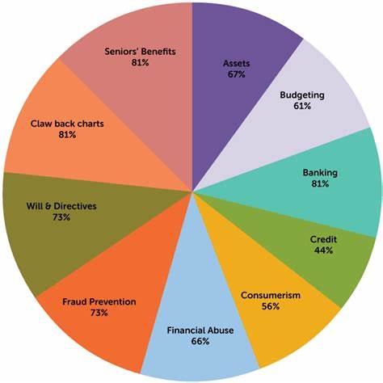
GRAPH:

Slide 17
ADVANTAGES OF FINANCIAL MANAGEMENT
Wastage management ensures that all fnancial resources are efciently utlised and there is no
Financial management aims at raising the proft of the concern and wealth of the shareholders

Slide 18
DIADVANTAGES OF FINANCIAL MANAGEMENT
These tools are costly to use and are tme consuming controlling and measuring the cost, fnancial management implies various fnancial control tools.
●Financial management leads to rigidity by setng certain standards for measure performance.

Slide 19
Very difcult task. Financial management requires determinaton of standards for measuring actual performance
Startng of process but,its implementaton become difcult during operThe fnancial control measures put forward by fnancial management caton of the process

Slide 20
CONCLUSION :
Rising of fund and utilization of fund is very important aspect of organization.
Every organization should have planned to utilize fund in efficient manner.“Management accountants focus on forecasting.
They have an exciting and forward-looking strategic role in many different types of organizations.

Slide 21
They use various tools, such as ratio analysis and investment appraisal, to identify measure and analyze the financial performance of a company.
Many CIMA-trained management accountants are at the heart of top businesses in a wide variety of roles, including financial analyst or finance director

Slide 22
REFERENCE:
1. URL:
https://www.bdc.ca/en/articlestools/money-finance/managefinances/pages/6-steps-to-createyour-companys-financial-plan.aspx
2. URL:
http://ccs.infospace.com/ClickHandl
er.ashx?
3. Chartered Institute of Management
Accountants | Financial information
in decision
making, URL:
http://businesscasestudies.co.uk/cim
a/financial-information-in-decisionmaking/conclusion.htm

